Slide 1
Trees
Fall 2024
School of Software Engineering
South China University of Technology

Slide 2


Content
Definitions of tree
Binary tree
AVL tree
Splay tree
B-tree

Slide 3

Why Do We Need Trees?
Lists, Stacks, and Queues are linear relationships
Information often contains hierarchical relationships
File directories or folders
Moves in a game
Hierarchies in organizations
Can build a tree to support fast searching

Slide 4
Tree Jargon
nodes and edges
parent, children, siblings
ancestors, descendants
root, leaves
subtrees
path, path length
Length of a path = number of edges
A
B
C
D
E
F

Slide 5
More Tree Jargon
Depth of a node N = length of path from root to N
Height of node N = length of longest path from N to a leaf
Depth of tree = depth of deepest node
Height of tree = height of root
depth=0,
height = 2
A
B
C
D
depth=1,
height =0
E
F
depth = 2,
height=0

Slide 6
Definition and Tree Trivia
A tree is a set of nodes, i.e., either
it’s an empty set of nodes, or
it has one node called the root from which zero or more trees (subtrees) descend
Two nodes in a tree have at most one path between them
Can a non-zero path from node N reach node N again?
No. Trees can never have cycles (loops)

Slide 7
Paths
A tree with N nodes always has N-1 edges (prove it by induction)
Base Case: N=1 one node, zero edges
Inductive Hypothesis: Suppose that a tree with N=k nodes always has k-1 edges.
Induction: Suppose N=k+1…
The k+1st node must connect
to the rest by 1 or more edges.
If more, we get a cycle. So it connects by just 1 more edge
k
+1

Slide 8
Implementation of Trees
One possible pointer-based Implementation
tree nodes with value and a pointer to each child
but how many pointers should we allocate space for?
A more flexible pointer-based implementation
1st Child / Next Sibling List Representation
Each node has 2 pointers: one to its first child and one to next sibling
Can handle arbitrary number of children

Slide 9
Arbitrary Branching
A
Data
B
C
D
FirstChild Sibling
A
E
F
B
C
D
Nodes of same depth
E
F

Slide 10
Implementation of Trees
//Node declarations for trees
Struct TreeNode{
Object element;
TreeNode *firstChild;
TreeNode *nextSibling;
};

Slide 11
Binary Trees
图片来自互联网

Slide 12
Binary Trees
Every node has at most two children
Most popular tree in computer science
Given N nodes, what is the minimum depth of a binary tree?
This means all levels but the last are full!
At depth d, you can have N = 2^{d} to N = 2^{d+1}-1 nodes
2^d <= N < 2^（d+1）=> d <= logN < (d+1)
=> logN - 1 < d <= logN

Slide 13
Minimum depth vs node count
At depth d, you can have N = 2^{d} to 2^{d+1}-1 nodes
minimum depth d is Θ(log N)
T(n) = Θ(f(n)) means
T(n) = O(f(n)) and f(n) = O(T(n)),
i.e. T(n) and f(n) have the same growth rate
1
d=2
N=2² to 2³-1
(i.e, 4 to 7 nodes)
2
3
4
5
6
7

Slide 14
Minimum depth vs node count
What is the maximum depth of a binary tree?
Degenerate case: Tree is a linked list!
Maximum depth = N-1
1
A linked list with high overhead
and few redeeming characteristics
2
3
4
5
6
7

Slide 15
Minimum depth vs node count
Goal: Would like to keep depth at around logN to get better performance than linked list for operations like Find

Slide 16
Binary Tree
template <typename E> class BinNode {
public:
virtual E& element() = 0; //return the node’s value
virtual void setElement(const E&) = 0; //set the node’s value
virtual BinNode* left() const = 0; //return the node’s left child
virtual void setLeft(BinNode*) = 0; //set the left child
virtual BinNode* right() const = 0; //return the right child
virtual void setRight(BinNode*) = 0; //set the right child
virtual bool isLeaf() = 0; //check if a node is a leaf or not
};
9
5
94
10
97
data
left right

Slide 17
Traversing Binary Trees
The definitions of the traversals are recursive definitions. For example:
Visit the root
Visit the left subtree (i.e., visit the tree whose root is the left child) and do this recursively
Visit the right subtree (i.e., visit the tree whose root is the right child) and do this recursively
Traversal definitions can be extended to general (non-binary) trees

Slide 18
Traversing Binary Trees
Preorder: Node, then Children (starting with the left) recursively
+ * + A B C D
Inorder: Left child recursively, Node, Right child recursively
A + B * C + D
Postorder: Children recursively, then Node
A B + C * D +
PO(+)
+
递
PO(*)
PO(D)
*
D
PO(+)
PO(C)
+
C
PO(A)
A
PO(B)
B
归
PO(NULL)
PO(NULL)
+ * + A B C D

Slide 19
Traversing Binary Trees
//Implementing preorder traversal as a recursive
// function
template<typename E>
void preorder(BinNode<E>* root){
if (root == NULL) return; //Empty subtree
visit(root); //Perform desired action
preorder(root->left());
preorder(root->right());
}

Slide 20
Traversing Binary Trees
Given two traversal enumerations, can you draw a unique binary tree?
Ex1:
preorder: G H I J;
inorder: I H G J
Ex2:
Postorder: D E C B H G F A
Inorder: B D C E A F H G
G
H
J
I
A
B
F
C
G
D
E
H

Slide 21
Binary Search Trees
9
Binary search trees are binary trees in which
all values in the node’s left subtree are less than node value
all values in the node’s right subtree are greater than value (not less than) node
Operations:
Find, FindMin, FindMax, Insert, Delete
5
94
10
97
What happens when we traverse a BST in inorder?
96
99

Slide 22
Binary Search Trees
data
9
9
left right
5
94
5
94
10
97
10
97
96
99
96
99

Slide 23
Find
/**
* test if an item is in a subtree.
* x is item to search for.
* t is the node that roots the subtree.
*/
bool contains( const Comparable & x, BinaryNode *t ) const{
if( t == nullptr ) return false;
else if( x < t->element ) return contains( x, t->left );
else if( t->element < x ) return contains( x, t->right );
else return true; // Match
}

Slide 24
FindMin
Design recursive FindMin operation that returns the smallest element in a binary search tree.
/**
* find the smallest item in a subtree t.
* Return node containing the smallest item.
**/
BinaryNode * findMin( BinaryNode *t ) const{
if( t == nullptr ) return nullptr; // root is empty
if( t->left == nullptr ) return t; //left child is empty
return findMin( t->left );
}

Slide 25
Insert
Challenge: how to preserve the BST property without making major changes to the structure of the tree
Do a “Find” operation for X
If X is found → update (no need to insert)
Else, “Find” stops at a NULL pointer
Insert Node with X there
Example: Insert 95
94
94
10
97
?
10
97
96
99
96
99
95

Slide 26
Insert
How to handle duplicates?
Example: Insert 97
94
94
10
97
10
97
?
96
99
96
99
97
Construct a new node and insert it into the tree. or,
keeping an extra field in the node record indicating the frequency of occurrence, etc.

Slide 27
Insert
/**
* Internal method to insert into a subtree.
* x is the item to insert.
* t is the node that roots the subtree.
* Set the new root of the subtree.
*/
void insert( const Comparable & x, BinaryNode * & t ){
if( t == nullptr )
t = new BinaryNode{ x, nullptr, nullptr };
else if( x < t->element )
insert( x, t->left );
else if( t->element < x )
insert( x, t->right );
else
; // Duplicate; do nothing
}
t
94
t
10
97
t
96
99
t
nL
95

Slide 28
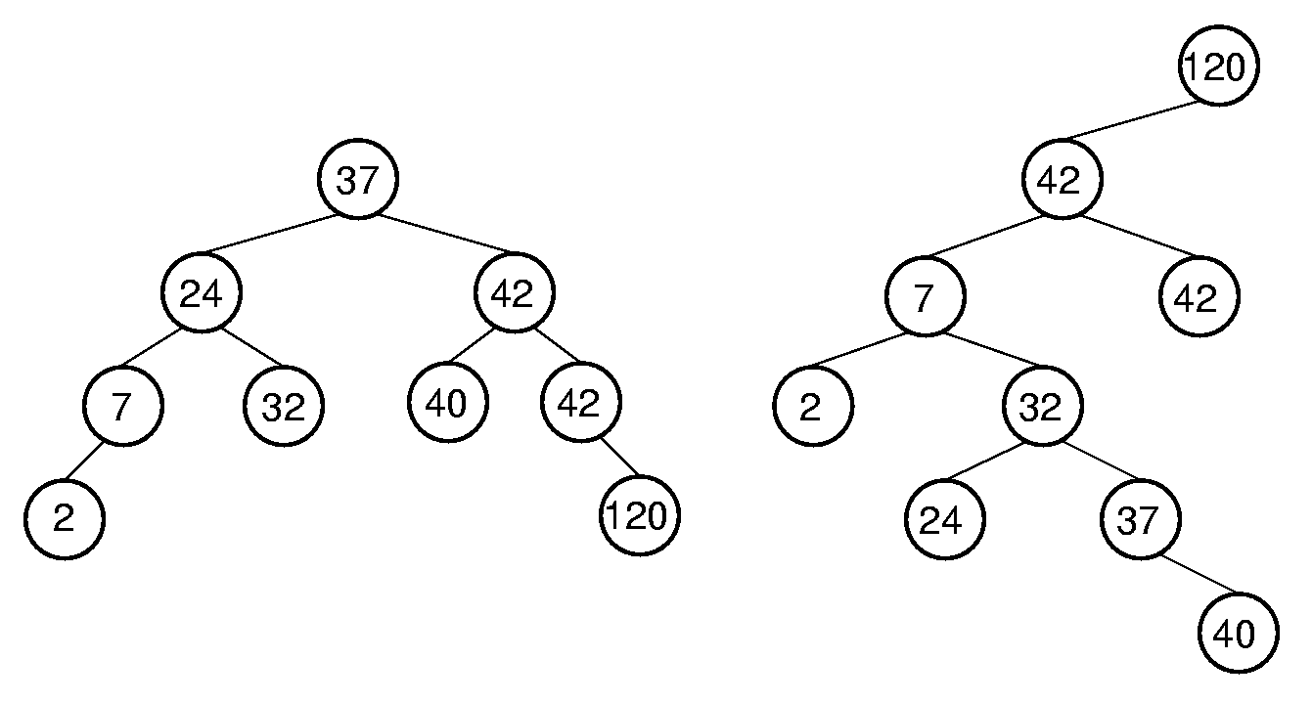
Insert
The shape of a BST depends on the order in which elements are inserted.
Left BST: 37, 24, 42, 7, 2, 40, 42, 32, 120
Right BST: 120, 42, 42, 7, 2, 32, 37, 24, 40
What if nodes are inserted in a sorted order?

Slide 29
Delete
94
Delete is a bit trickier…Why?
Suppose you want to delete 10
Strategy:
Find 10
Delete the node containing 10
Problem: When you delete a node,
what do you replace it by?
10
97
5
24
11
17

Slide 30
Delete
94
Problem: When you delete a node,
what do you replace it by?
Solution:
If it has no children, by NULL
If it has 1 child, by that child
If it has 2 children, by the node with the smallest value in its right subtree (the successor of the node)
10
97
5
24
11
17

Slide 31
Delete
Delete node with no children
94
94
Find 5 node
10
97
10
97
Then Free
the 5 node and
NULL the
pointer to it
5
24
5
24
11
11
17
17

Slide 32
Delete
Delete node with one child
94
94
Find 24 node
10
97
10
97
Then Free
the 24 node and
replace the
pointer to it with a pointer to its child
5
24
5
24
11
11
17
17

Slide 33
Delete
Delete node with two children
94
94
10
97
11
97
5
24
5
24
Then (recursively) Delete node with smallest value
in right subtree
Note: it cannot have two children (why?)
11
11
Find 10,
Copy the smallest
value in right subtree
into the node
17
17

Slide 34
Delete
Delete node with two children (continued)
94
94
11
97
11
97
5
24
5
24
Then Free the 11 node and replace the pointer to it with a pointer to its child
11
11
Remember
11 node
17
17

Slide 35
Remove (delete)
/**
* remove from a subtree. Textbook page 140
* x is the item to remove. t is the node that roots the subtree.
* Set the new root of the subtree.
*/
void remove( const Comparable & x, BinaryNode * & t ){
if( t == nullptr ) return; // Item not found; do nothing
if( x < t->element ) remove( x, t->left );
else if( t->element < x ) remove( x, t->right );
else if( t->left != nullptr && t->right != nullptr ){// Two children
t->element = findMin( t->right )->element;
remove( t->element, t->right );
}
else{
BinaryNode *oldNode = t;
t = ( t->left != nullptr ) ? t->left : t->right;
delete oldNode;
}
}

Slide 36
Analysis of BST
Cost of finding, insertion, and removal (one node) is the depth of the deepest node in the tree
Desirable to keep BSTs balanced, that is, with least possible height
Balanced BST in average case: Θ(log n)
Unbalanced BST in worst case: Θ(n)
Traverse cost: Θ(n)
It is preferable for a BST to be as shallow as possible

Slide 37
Homework
Homework 3-1
Textbook Exercises 4.2, 4.5, 4.9

